Slide 1
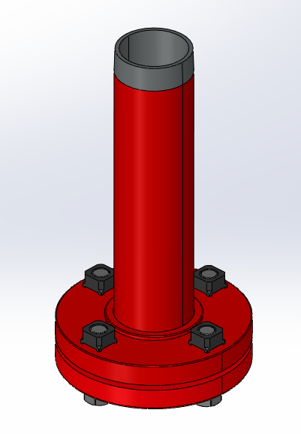
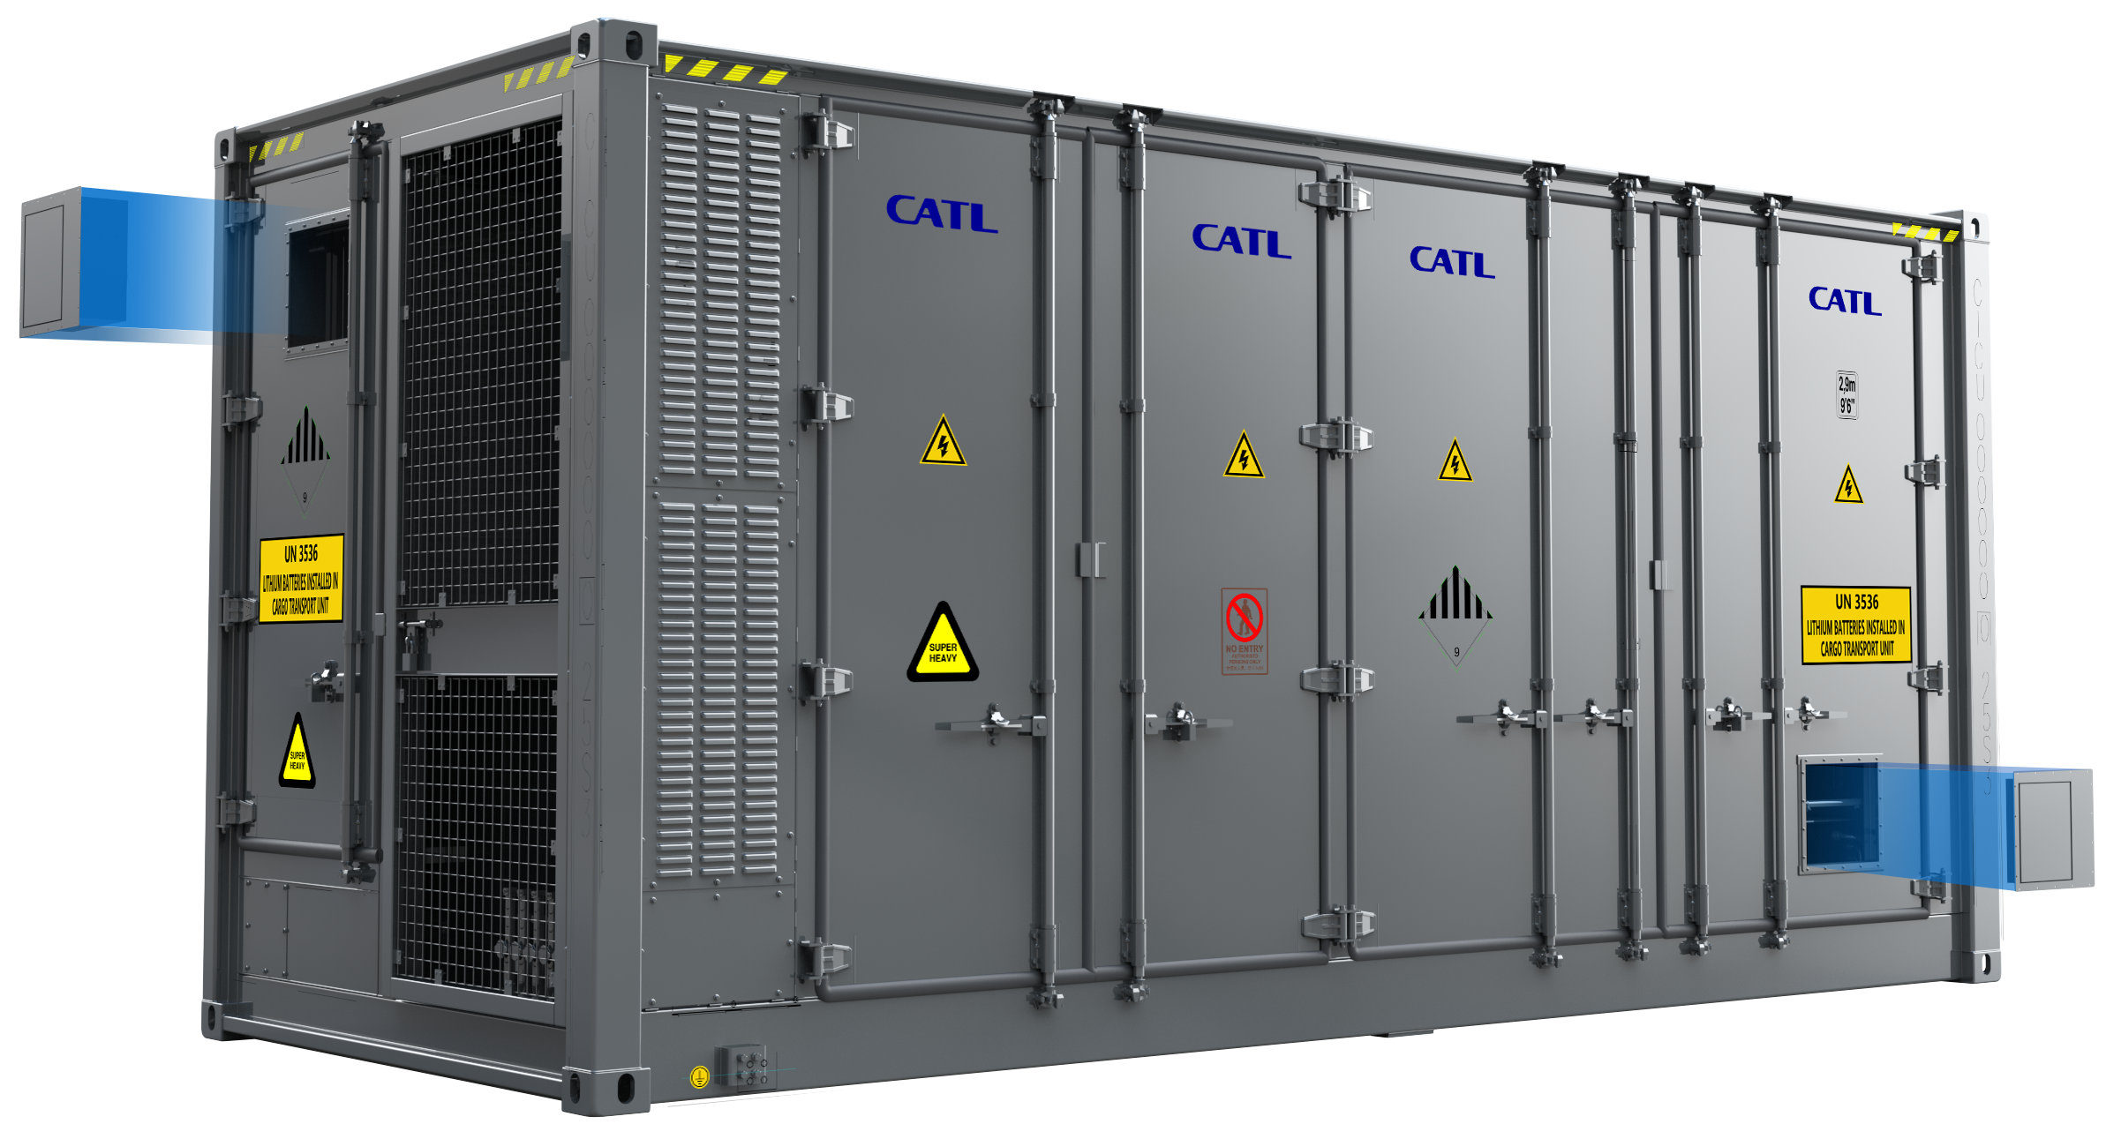
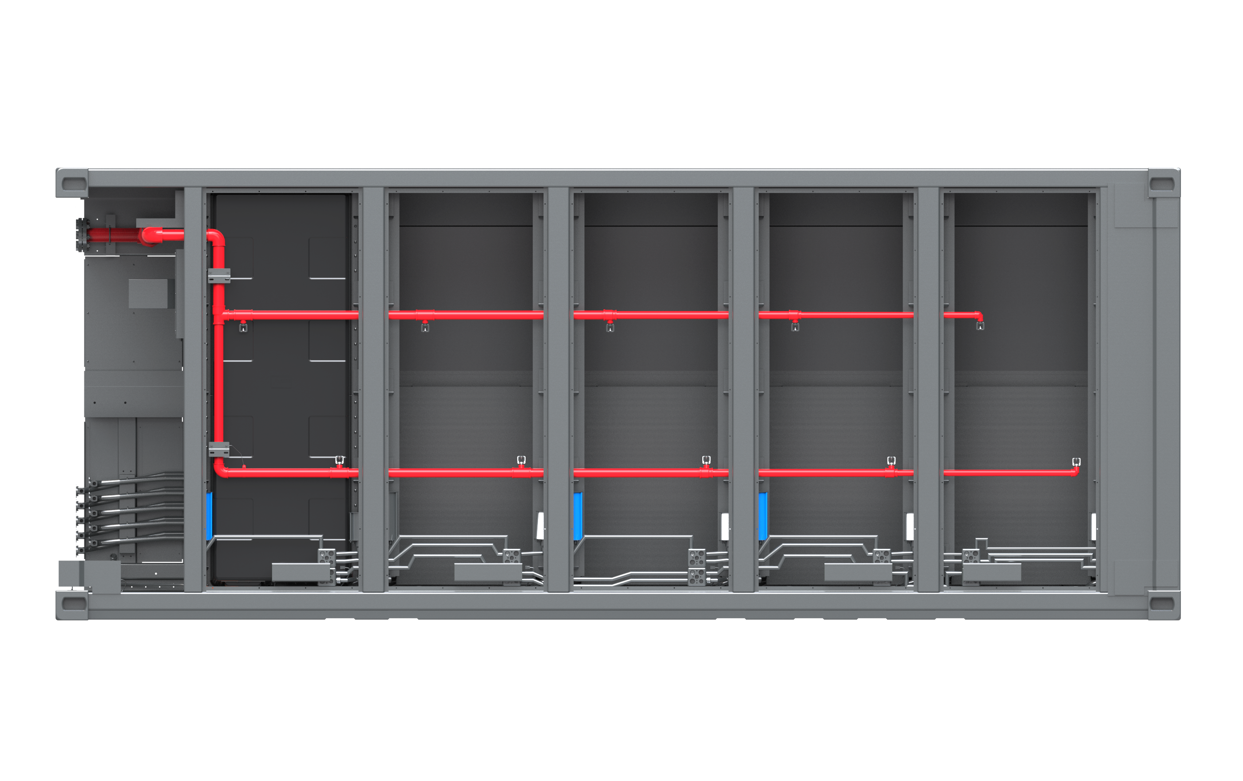
EnerC+ Product Overview - Fire Suppression System
Smoke exhaust ventilation fan system
When the combustible gas in the container accumulates, the Smoke exhaust ventilation fan system is started to prevent deflagration
Smoke exhaust ventilation fan system meets NFPA69 standard
Dry pipe system(Optional)
As the last line of defense, the dry pipe system can effectively control the spread of fire.
The dry pipe system meets NFPA855 standard
Pipe design ASTM， Color: RAL 3000 (Red).
Top View
Flange
Dry pipe
Outlet
Inlet
Nozzle
*Confidential 秘密
The picture is for reference only

Slide 2
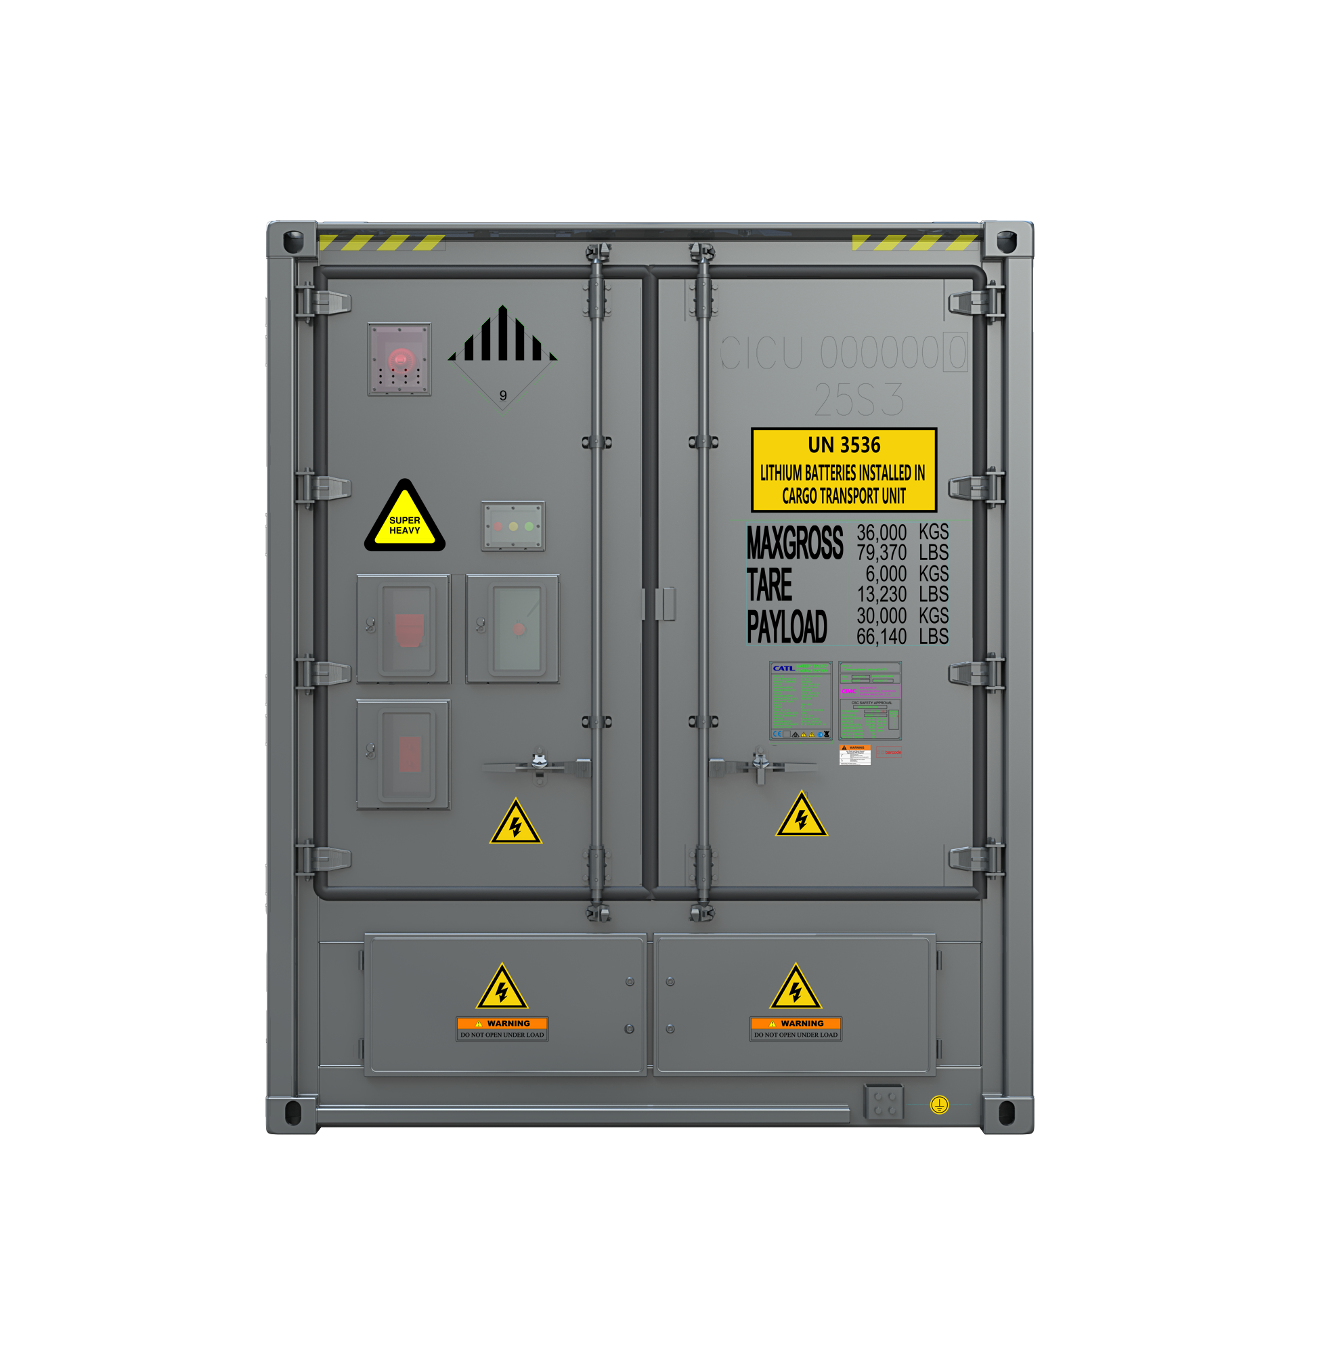
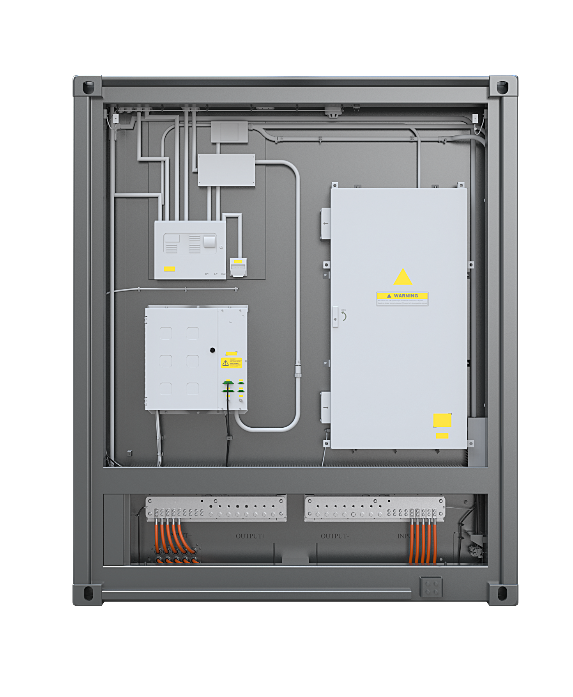
Ener C+ Product Overview - Fire Suppression System
Horn-Strobe
Fire control panel
Aerosol manual Start button
Emergency stop button of auxiliary source
Aerosol manual stop button
Ventilation Fan manual start-stop button
Exterior of electrical compartment
Interior of electrical compartment
No | Type | Quantity | Configuration | Remarks
1 | Horn-Strobe | 1 | Standard | Alarm
2 | Aerosol manual Start button | 1 | Standard | Release aerosol manually
3 | Ventilation Fan manual start-stop button | 1 | Standard | Start and stop of Smoke exhaust ventilation fan controlled manually
4 | Emergency stop button of auxiliary source | 1 | Standard | Manually cut off the auxiliary source
5 | Fire control panel | 1 | Standard | Control the fire suppression system
6 | Aerosol manual stop button | 1 | Standard | Manually shut down the Aerosol fire suppression system
The picture is for reference only
*Confidential 秘密

Slide 3
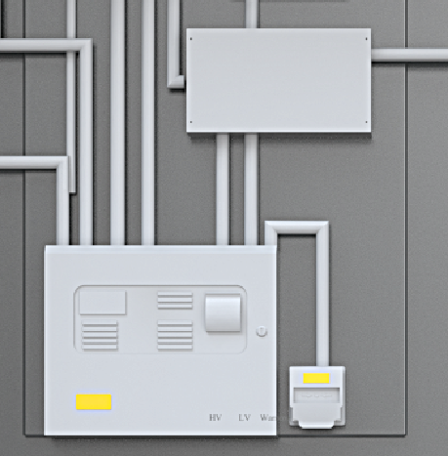
Installation Interface – Containers Cable Connection
D. FSS dry contact interface
  There are three dry contact interfaces in FSS.
    Fault Signal
    Level 1 Alarm Signal
    Level 2 Alarm Signal
FSS dry contact
Pin | Function | Dry contact Status | External FSS or EMS Action
FSS Fault Signal+ and FSS Fault Signal- | To indicate the fault of FSS in battery container. | Close | No action
 |  | Open | Cut off PCS power by EMS and check the detail fault information on the FSS.
FSS Level 1 Alarm+ and FSS Level 1 Alarm- | To indicate that Any one sensor of FSS is in alarm. Smoke exhaust ventilation FAN is in alarm. Start up smoke exhaust ventilation FAN. | Close | No action
 |  | Open | Cut off PCS power by EMS and check the detail fault information on the FSS.
FSS Level 2 Alarm+ and FSS Level 2 Alarm- | 1）One Heat detector and one smoke detector give an alarm ; 2）two Heat detector give an alarm 3）Start up Aerosol manual Start button | Close | No action
 |  | Open | Cut off PCS power by EMS.
3
*Confidential 秘密
The picture is for reference only

